Slide 1

Rajiv Gandhi University of Knowledge and Technologies,Srikakulam
Department of Computer Science and Engineering
Major project-2
Safe URL Checker using Machine Learning and Deep Learning Models
Under the Guidance of
Mrs. M.Roopa, M.Tech
Assistant Professor ,CSE Department
External Guide:
Mr.Dileep Kumar koda,M.Tech,(Ph.D)
Assistant Professor,CSE Department
Batch :25
1. P. Sree Bhavani (S190008)
2. M.Lakshmi Divya(S190185)
3. S. Komali Devi (S190018)
4. P. Manasa (S190980)

Slide 2

Safe URL Checker
using Machine Learning and
Deep Learning Models

Slide 3
Topics to be discussed:
01
Abstract
02
Introduction
03
Problem Statement
04
Existing System
05
Proposed System
06
conclusion & Future Work

Slide 4
Abstract
This project aims to creates a model to detect phishing websites using machine learning and deep learning methods by taking the url as input. The system looks at different parts of the website's URL, like its length and special characters and more other features to decide if the site is safe or harmful i.e legitimate or phishing. It also checks the content of the website for any suspicious signs. The project uses machine learning techniques like Xgboost and catboost, as well as deep learning models like CNN (Convolutional Neural Networks) and LSTM (Long Short-Term Memory). The aim is to build a tool that protect users from phishing attacks via links while browsing the internet and the creation of user interface. Along with suggesting the safe links in case of a link is found to be harmful.
Keywords: Phishing,Legitimate ,Classification,Xgboost,Catboost,CNN,LSTM

Slide 5
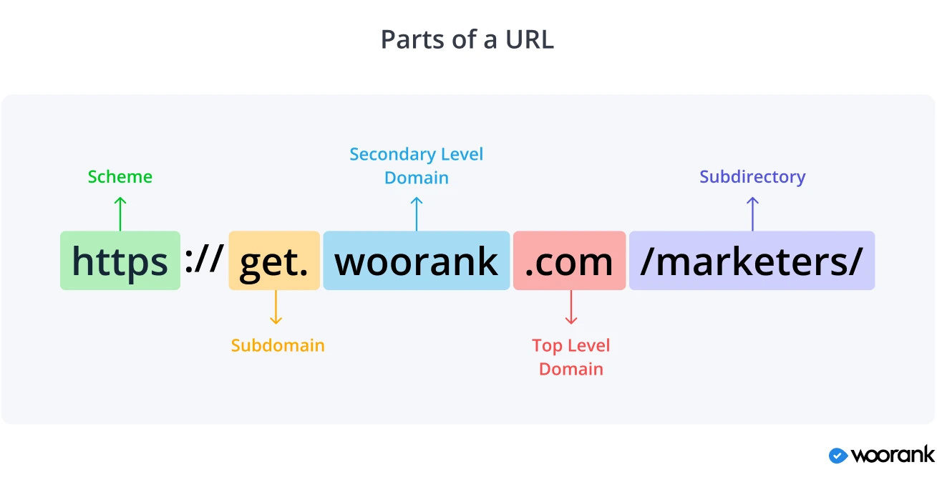

Slide 6
Introduction
Phishing is a common cyberattack where hackers trick users into sharing confidential information like passwords,credit card numbers or personal details by pretending to be trusted websites. They misuse this information for fraudulent activities.As the internet grows, phishing attacks are becoming more frequent and dangerous. To protect users, we need better ways to detect phishing websites.
Traditional methods like blacklists are not enough because new phishing sites keep appearing. This is why machine learning (ML) and deep learning (DL) algorithms are important.These models analyze website URLs and content to classify sites as safe or phishing, helping users avoid scams and stay safe online.

Slide 7
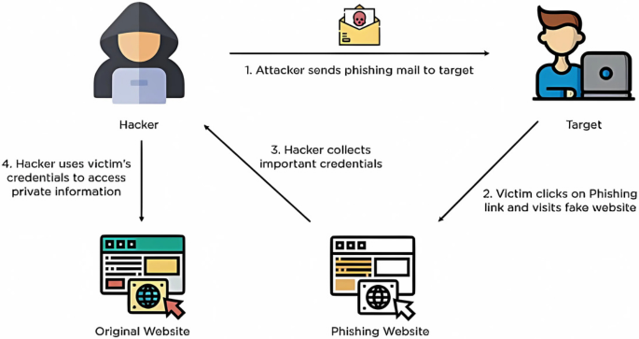
How Phishing will be performed:

Slide 8

Problem Statement
Phishing websites use fake URLs to trick users into sharing personal information or downloading harmful software. These attacks are becoming more common and harder to detect because scammers constantly change their methods. The goal of this project is to build a model that can accurately identify phishing URLs and protect users from online threats. The model should be able to analyze large numbers of URLs quickly and provide reliable results, helping to keep users safe while browsing the internet by allowing the user interaction and suggestion of safe links for the phshing links found.

Slide 9
Existing System
The current system for detecting phishing websites analyzes URL features like length, special characters and domain age etc., to determine if a site is phishing or legitimate. It uses machine learning algorithms such as Random Forest, Support Vector Machine, Naive Bayes and Decision Trees to classify websites. The data for training is collected from sources like PhishTank, which provides known phishing sites. After training, the model can quickly analyze new URLs and predict if they are safe or phishing. Random Forest has shown an accuracy of 87% and Decision Tree perform with 84% accuracy in identifying phishing sites.

Slide 10
Drawbacks of Existing System
False Positives
Lack of Deep Learning use
It sometimes wrongly flags safe websites as phishing, causing inconvenience
More advanced approaches like deep learning, which might handle complex patterns better, are not utilized in these systems.
Slow Processing
Some methods, like Gradient Boosting, take longer to run, making it hard to detect phishing in real-time.

Slide 11
Proposed System
The proposed system consists of several key components to effectively detect phishing URLs and safeguard users from online threats:
URL Analysis: The system first examines various features of the URL, such as its length, domain age and presence of special characters etc., Based on these features, the system predicts whether the URL is safe or phishing.
Content Analysis: If the URL is classified as legitimate, the system performs a deeper content analysis by scanning the website for suspicious terms (e.g., "login", "verify", "update password"). In addition, the system checks for the presence of internal links, login forms which might indicate phishing attempts. If any suspicious keywords or internal links are found, the system alerts the user, displaying the risky terms and internal link.

Slide 12
Proposed System
Safe links suggestion: The system first examines the url,if the url is identified as a phishing url then this model will suggest a safe link to the user corresponding to the entered url by analysing the keywords and specified or popular daomain names which are there in the url given.
User Interface : In this project, we are aiming to built the user interface for the smooth and easy user interaction.This will allow the user to check the suspected url safety with just a single click.All the above mentioned procedures will be get by the user with a single click only.

Slide 13

Proposed System
The proposed system enhances detection by using advanced machine learning(XGBoost and CatBoost) and deep learning algorithms( LSTM and CNN). By combining URL feature analysis and content inspection, along with advanced algorithms, the system aims to offer more accurate and reliable detection of phishing websites, ensuring better protection for users.

Slide 14
Advantages of Proposed System
Improved Accuracy
Better Feature Detection
Using advanced algorithms like XGBoost, CatBoost, CNNs, and LSTMs increases the accuracy of detecting phishing websites
New features like tld_in_subdomain and ‘empty_title’ checks enhance the system’s ability to detect suspicious websites.
Content Analysis
Comprehensive Protection
It not only checks if the URL is safe but also analyses webpage content for potential risks, providing a deeper layer of protection.
The system combines multiple layers of defence, making it more effective against phishing attacks.

Slide 15
Advantages of Proposed System
*Efficient User Interaction**
safe link suggestion
The user inerface we built in project,improves the user interaction and helps the user for the better information retrieval.
If the user is got directed to a harmful url and found it is harmful with the help of this project .Then this system we developed will help the user to get the corresponding safe links possible.

Slide 16
Data Collection
Phishing URLs:
We collected 4,770 phishing URLs from PhishTank, an open-source service that provides verified phishing URLs. The data was downloaded in CSV format for easy processing.
Legitimate URLs
For legitimate URLs, we used a dataset from the University of New Brunswick, which contains a total of 35,500 legitimate URLs. From this collection, we selected 4,770 legitimate URLs to balance our dataset.

Slide 17
Features
For our phishing detection model, we used several key features to evaluate the legitimacy of URLs.Those features including :
'Domain','Have_IP','Have_At','URL_Length',’URL_Depth',’Redirection','Web_Forwards','Label','http_Domain','https_Domain',‘TinyURL','Prefix/Suffix','Domain_Age','Domain_end_period','dns_records','empty_title','tld_in_subdomain','is_indexed','iFrame', 'Mouse_Over', 'Right_Click'
After applying correlation threshold of 0.1 ,The features considered are 'Have_At', 'URL_Length','URL_Depth', 'Prefix/Suffix','Domain_Age', 'Domain_end_period', 'dns_records', 'empty_title', 'tld_in_subdomain', 'iFrame', 'Web_Forwards'

Slide 18
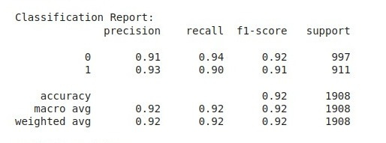
ALGORITHMS USED
XGBoost (Extreme Gradient Boosting)
XGBoost is a highly efficient and powerful gradient-boosting algorithm based on decision trees. It works by combining multiple weak models (trees) into a strong predictive model. It’s designed to handle large datasets and offers features like parallelization, regularization, and automatic handling of missing values, making it a popular choice for structured/tabular data.
Classification Report:

Slide 19
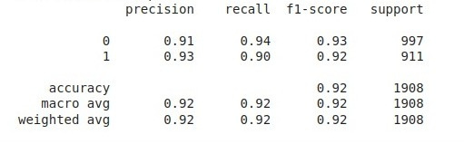
ALGORITHMS USED
CatBoost Algorithm
CatBoost is another gradient-boosting algorithm optimized for handling categorical data without requiring heavy preprocessing. It avoids overfitting better than xgboost and reduces prediction shift. CatBoost is particularly useful when datasets contain categorical variables and can handle both numerical and text data efficiently.
Classification Report:

Slide 20
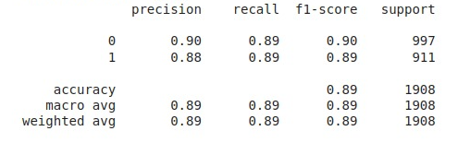
ALGORITHMS USED
Long Short-Term Memory (LSTM)
LSTM is a type of recurrent neural network (RNN) specialized in processing sequential data. LSTMs can “remember” important information across long sequences, making them ideal for analysing text, URLs, or sequences of characters. In phishing detection, LSTM models capture patterns in URLs, considering their sequence of characters or words to determine potential threats.
Classification Report:

Slide 21
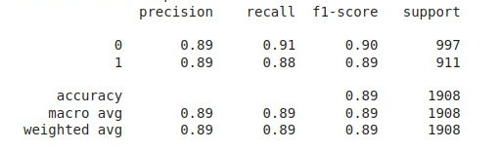
ALGORITHMS USED
Convolutional Neural Networks (CNNs)
CNNs are widely used in image recognition but can also handle structured data, like URLs, by learning spatial and hierarchical patterns. CNNs consist of convolutional layers that apply filters to detect patterns or features in data. For phishing detection, CNNs can recognize patterns in URL structures, domain names, and web content.
Classification Report:

Slide 22
Conclusion
This project successfully implements a machine learning-based system to detect phishing websites, enhancing user security while browsing. Several algorithms, including XGBoost, CNN, LSTM, and CatBoost, were tested, with CatBoost providing the highest accuracy of 92%. The system analyzes both URL features and website content to accurately identify phishing links. It also offers safe link suggestions and alerts users about suspicious keywords and internal links. The user-friendly interface ensures non-technical users can easily interact with the system. Overall, the system provides an effective solution to improve online safety and user awareness.

Slide 23
Future Work
In the future, we plan to enhance our phishing detection system with three key improvements:
Real-time Browser Extension Integration
Develop a browser extension (e.g., for Chrome or Firefox) that can check URLs in real time as users browse, alerting them instantly to phishing threats.
Extend the system to include dynamic behavior analysis, such as monitoring scripts, redirects, or pop-ups that activate after the page loads.
Dynamic Analysis of Websites:

Slide 24
Future Work
Mobile app that allows users to scan links received via SMS, email, or apps, offering protection beyond web browsing.
These enhancements will strengthen our system, making it more robust and effective in protecting users from phishing attacks.
Mobile Application Integration

Slide 25


